Slide 1
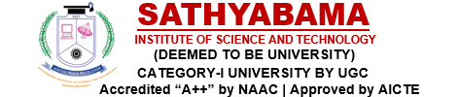
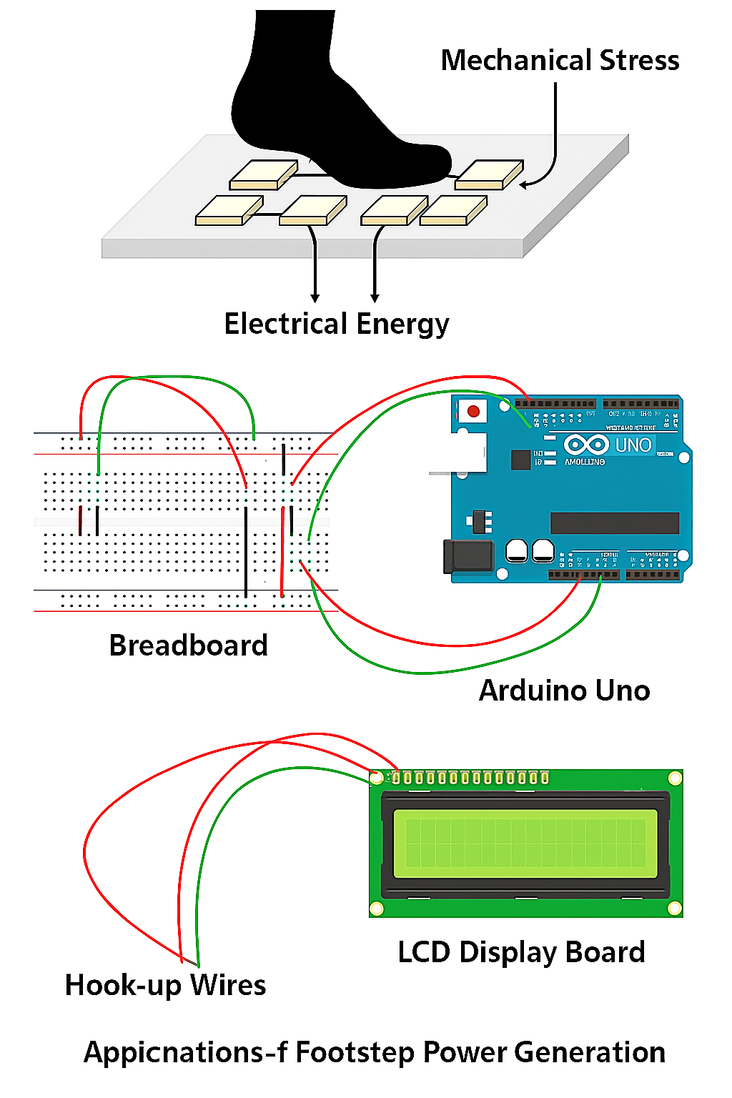
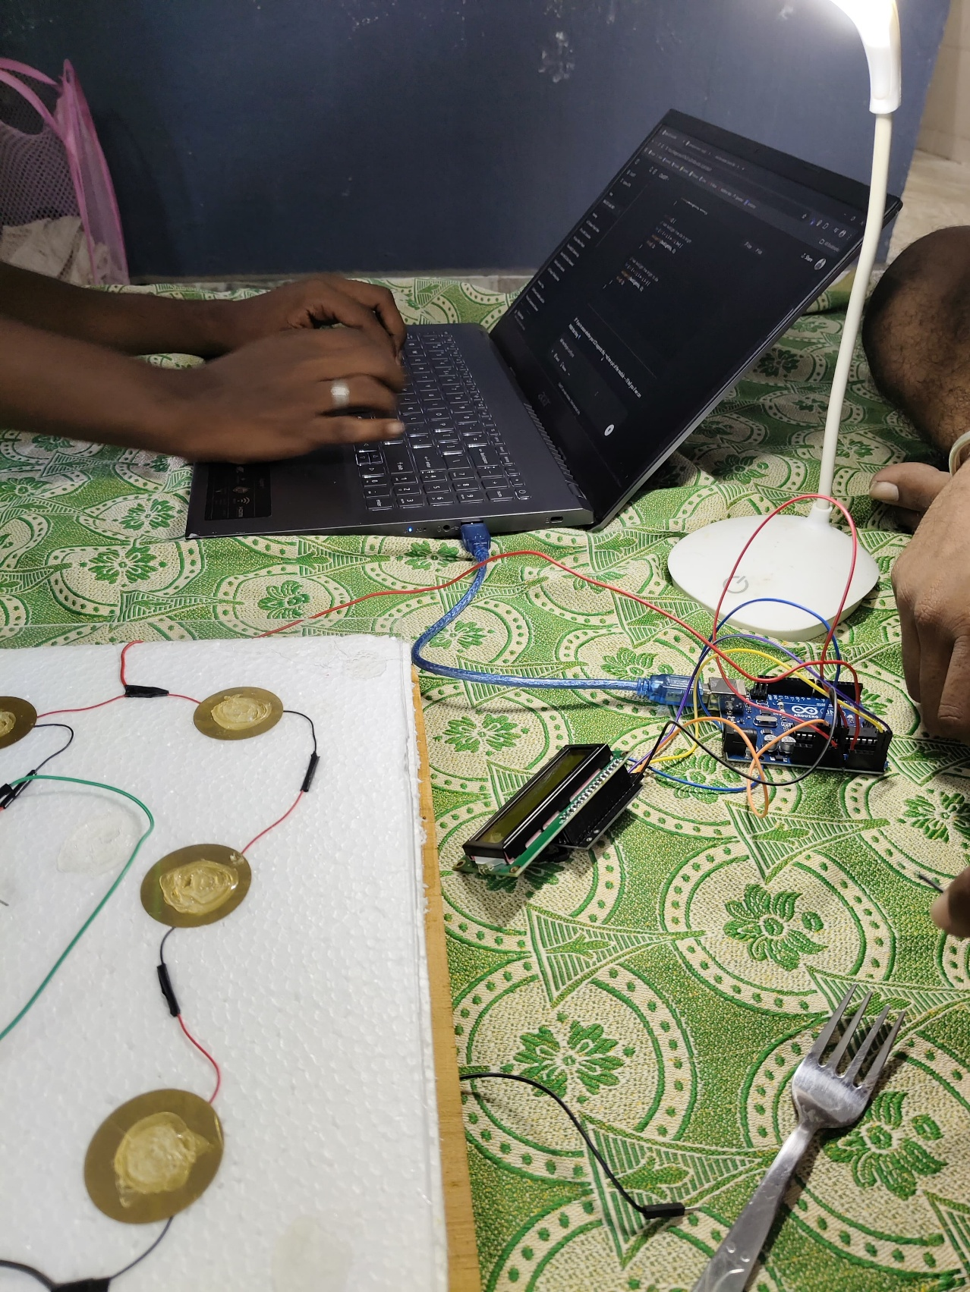
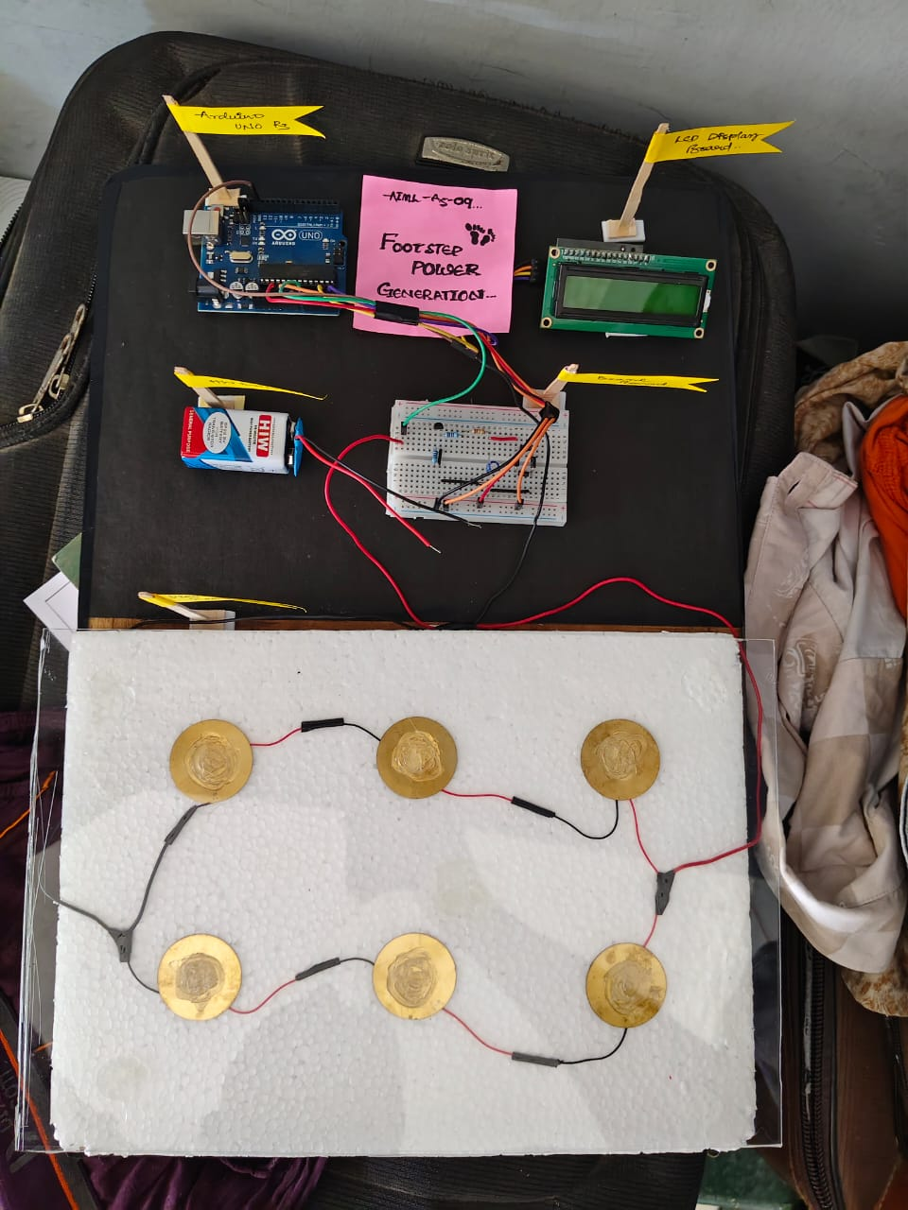
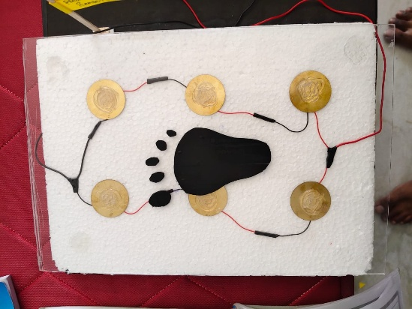
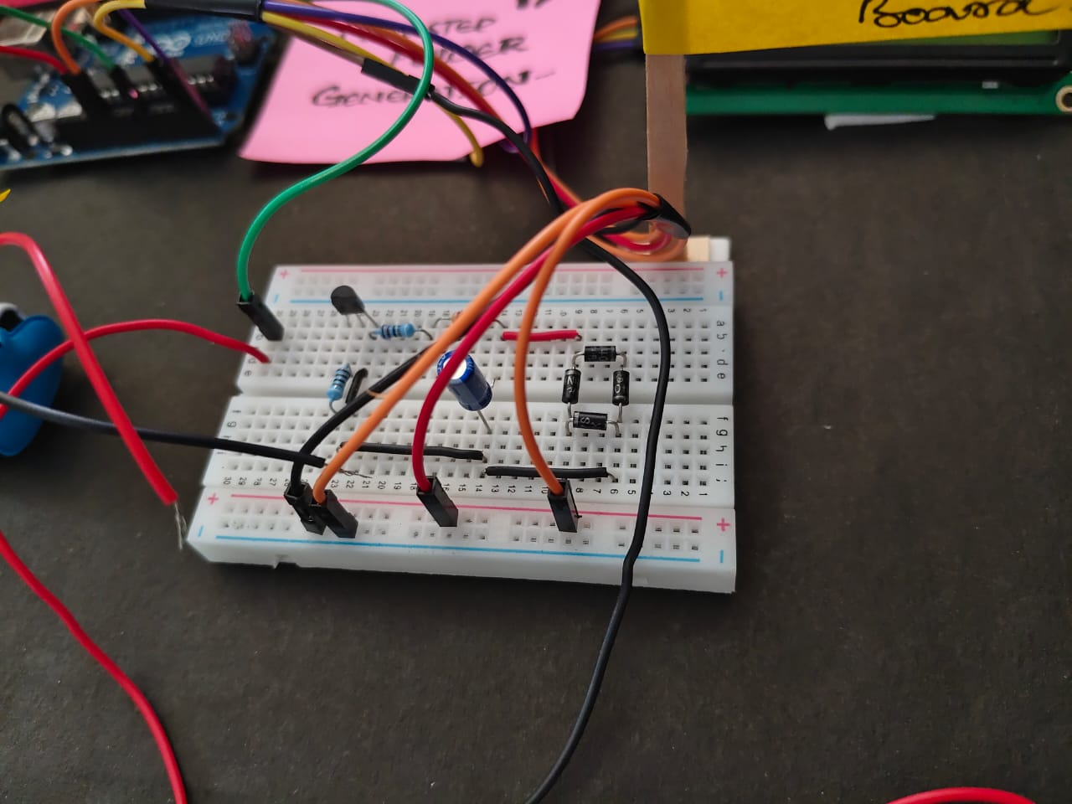
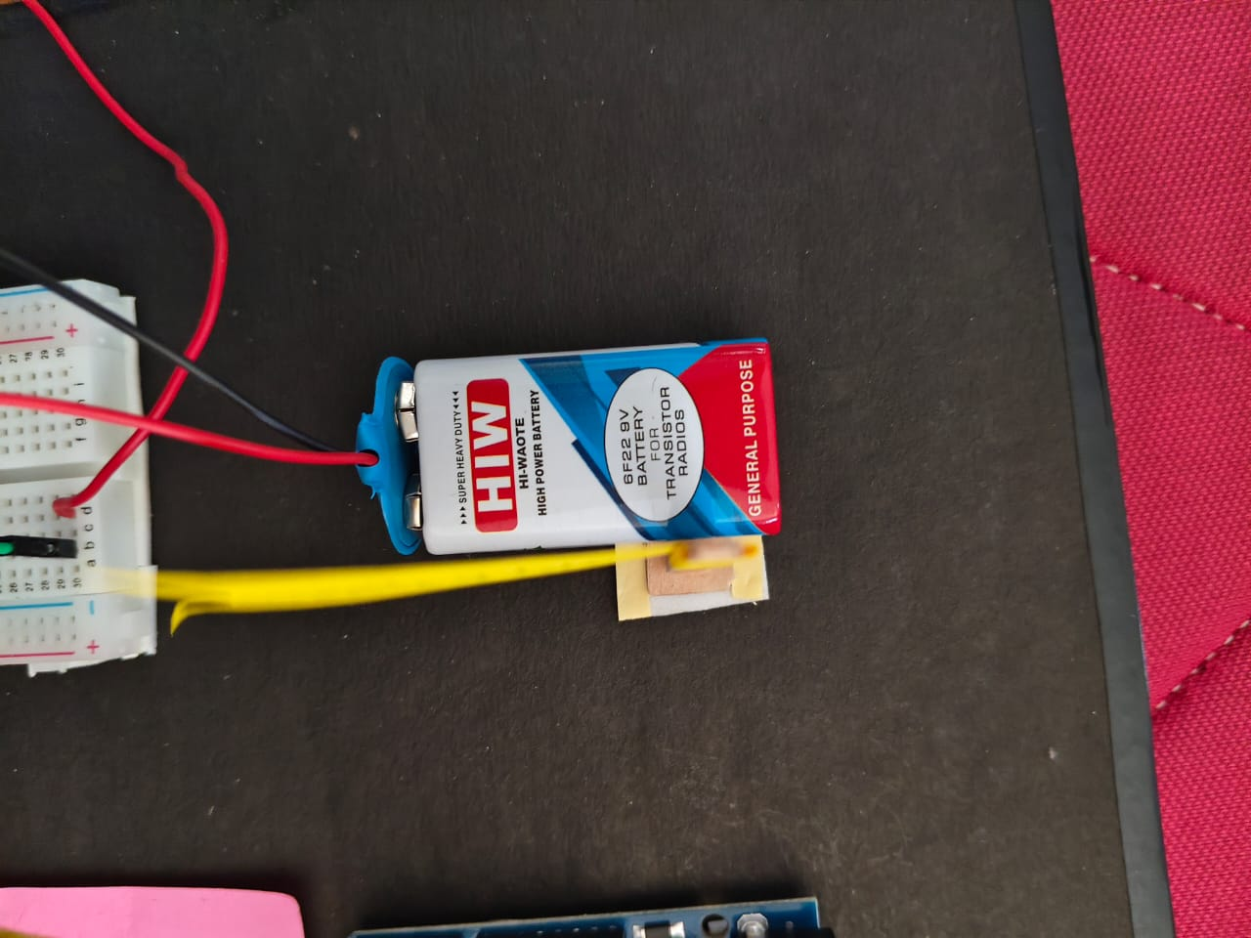
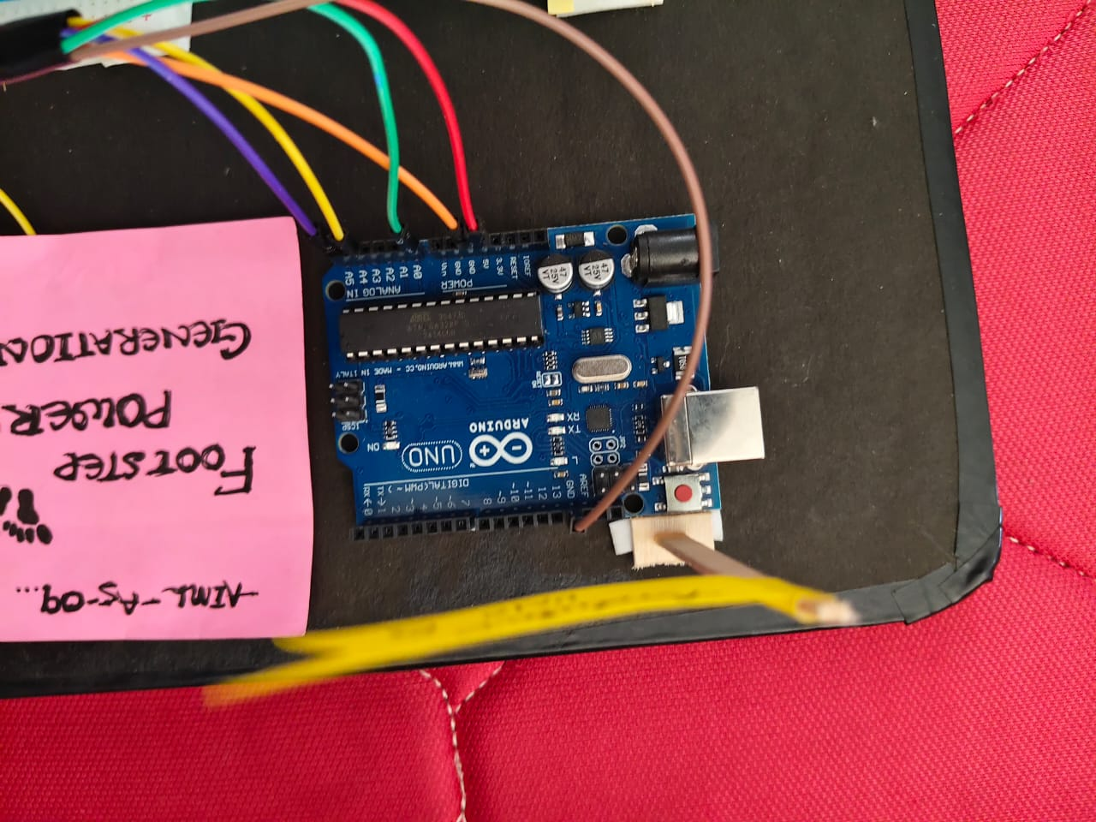
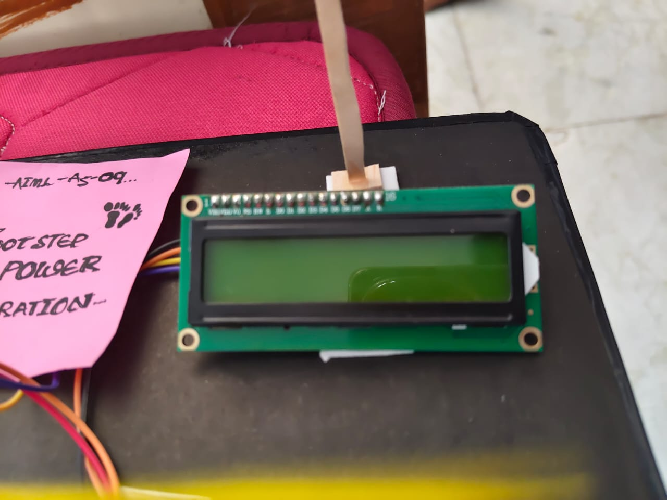
Mentored by:
N.Jeenath Shafana
M.E,(Ph.D)
Assistant Professor/CSE
FOOT STEP POWER GENERATION
M Ganesh, Vaibhav, Sudheer, Krishika, Sanjana, Harsh Pandey
Abstract
Proposed Methodology
Implementation and Results
Conclusions
Footstep power generation is a sustainable method that converts mechanical stress from walking into electrical energy using piezoelectric sensors. The generated power is processed through an Arduino and displayed via an LCD module. This system offers a clean, low-cost energy solution for high-footfall areas.
.
Footstep power generation is an innovative and eco-friendly method of harnessing renewable energy from everyday human activity. By converting mechanical stress into electrical energy using piezoelectric sensors, this system demonstrates a practical solution for powering low-energy devices in public and high-footfall areas. With the integration of Arduino and real-time monitoring, the project not only highlights energy efficiency but also encourages sustainable practices in modern infrastructure.
Implementation :
Objectives
To develop a system that converts mechanical stress from footsteps into electrical energy using piezoelectric sensors.
To design a circuit using Arduino Uno for processing and monitoring the generated energy.
To display real-time energy output on an LCD screen for analysis and awareness.
References
Hardware and Software Requirements
Result :
We are pleased to acknowledge our sincere thanks to Board of Management of Sathyabama Institute of Science and Technology for their kind encouragement in doing this project and for completing it successfully.
Introduction
Piezoelectric Sensors – Convert mechanical stress from footsteps into electrical voltage.
Arduino Uno – Processes sensor input and controls the output display.
Breadboard (Beard Board) – Provides a platform for connecting components without soldering.
Hook-up Wires – Used to make electrical connections between components.
LCD Display (16x2) – Displays voltage or energy output in real-time.
Diodes/Rectifier Circuit – Converts the AC voltage from piezo sensors into DC.
Capacitor/Rechargeable Battery – Stores the generated electrical energy for later use.
Voltage Regulator – Ensures a stable and safe output voltage.
Foot Support Base/Tile – Encases the piezo sensors and takes the physical load of footsteps.
Arduino IDE – Used to write, compile, and upload code to the Arduino for data handling and display.
To harness mechanical stress from footsteps and convert it into usable electrical energy.
To implement piezoelectric sensors for efficient energy conversion in high-footfall areas.
To design a cost-effective and eco-friendly system suitable for smart energy solutions.
To utilize Arduino Uno for real-time processing and display of generated power.
To promote renewable energy applications for low-power devices and awareness systems.
.
Novelty of the Project
The novelty of this project lies in its smart use of piezoelectric sensors to generate electricity from foot pressure. It uniquely combines energy harvesting with real-time display using Arduino and an LCD, making it both efficient and interactive in public or busy areas.
Acknowledgement
We would like to express our sincere gratitude to everyone who supported and guided us throughout the development of our project, "Footstep Power Generation Using Piezoelectric Sensors". We are especially thankful to our project guide, [Jeenath shafana Mam], for their valuable insights, encouragement, and continuous support that helped us bring this idea to life. We also extend our heartfelt thanks to the faculty and staff of [Dept of CSE] for providing the necessary resources and facilities. Our appreciation also goes to our teammates for their dedication and collaborative effort. Finally, we thank our families and friends for their moral support and encouragement during every stage of this project.

